Slide 1
The Phases of Culture

Slide 2
The Nomadic Society
The nomadic society, also known as hunters and gatherers, are constantly on the move in order to acquire food sources.
Since plants change with the seasons and animals follow the plants, human beings in a nomadic society therefore must follow these food resources around.
The members of the tribe rely on the interdependence of others in order to survive.
Interdependence is the mutual dependence between people, groups, states, etc., for goods, resources, and labor.
Roles in the nomadic society are based on survival skills and experience.

Slide 3
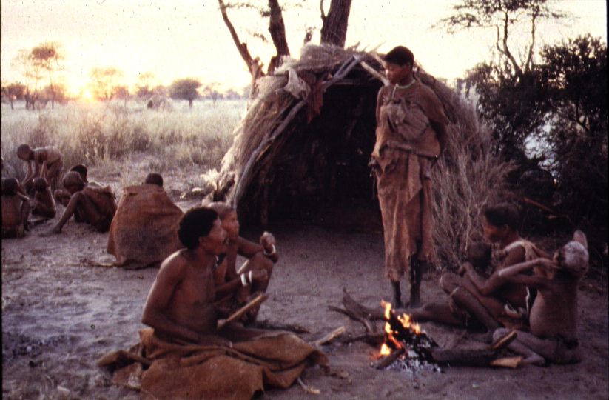
The Nomadic Society

Slide 4
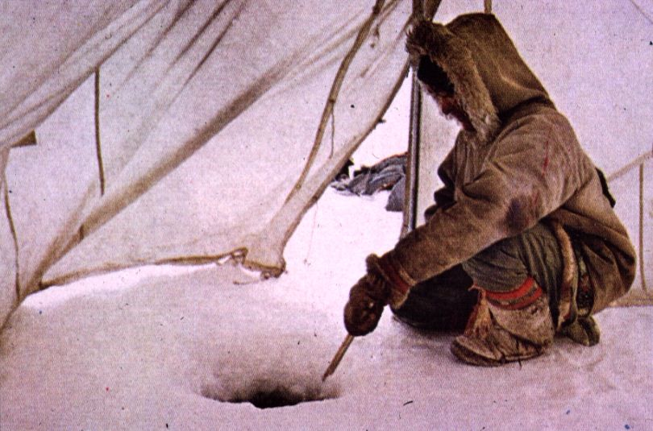
The Nomadic Society

Slide 5
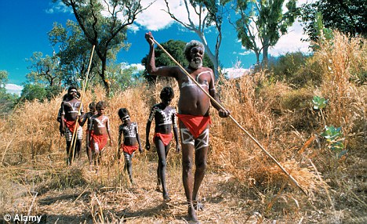
The Nomadic Society

Slide 6
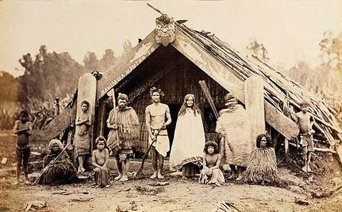
The Nomadic Society

Slide 7
The Agricultural Society
10,000 years ago, humans learned how to grow plants and domesticate animals.
This event is known as the Agricultural Revolution.
The impact of the Agricultural Revolution was significant for human development:
Humans now had a steady food source.
Settlements began as humans could remain stationary near their food source.
This settlement occurred in river valleys which offered fertile soil, abundant fresh water resources, and fishing.
Populations increased because of increased food supplies and the need for more labor.
Interdependence extended from the family to the village.
Land became the primary source of wealth.

Slide 8
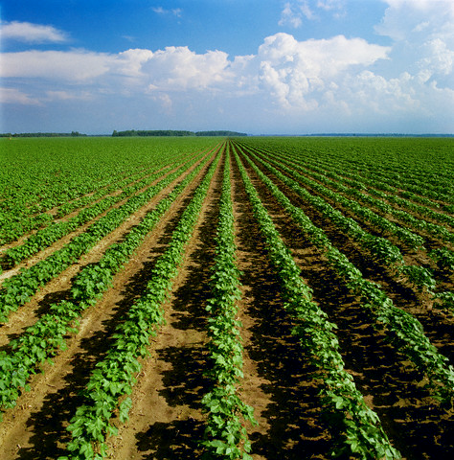
The Agricultural Society

Slide 9
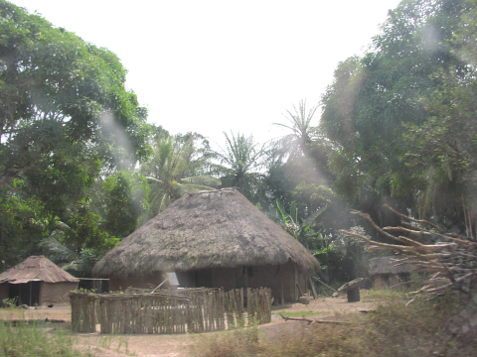
The Agricultural Society

Slide 10
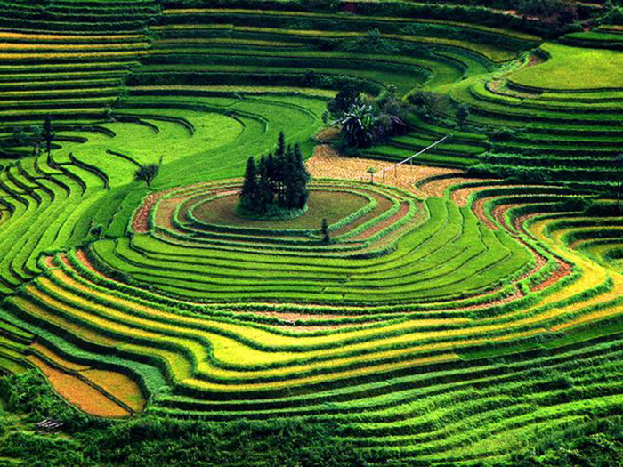
The Agricultural Society

Slide 11
The Agricultural Society
Pastoralists are people who live by tending and breeding domesticated animals.
Pastoralism is an adaption to less fertile lands.
Pastoralists have domesticated animals, but have not settled in villages to raise crops.
Livestock is the primary source of wealth.
Pastoralists are also known as nomadic herders.

Slide 12
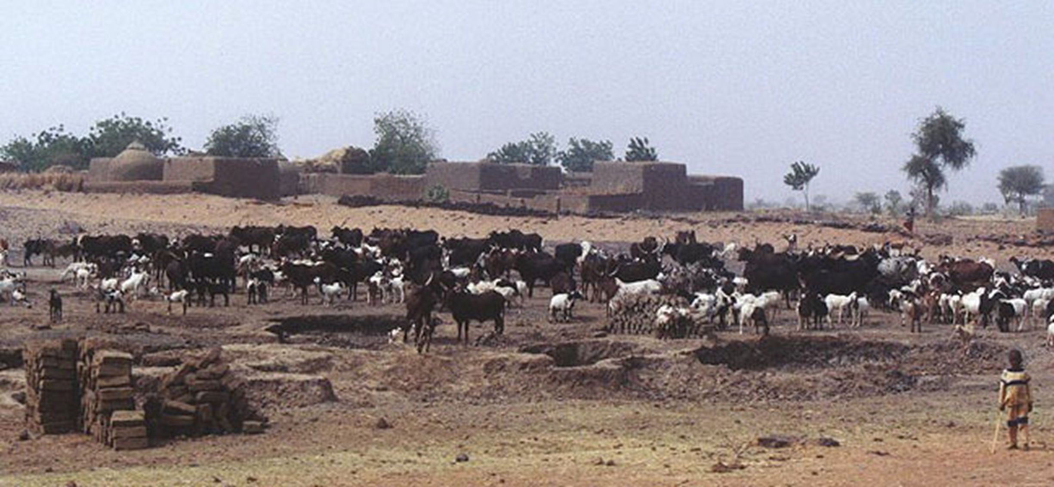
The Agricultural Society

Slide 13
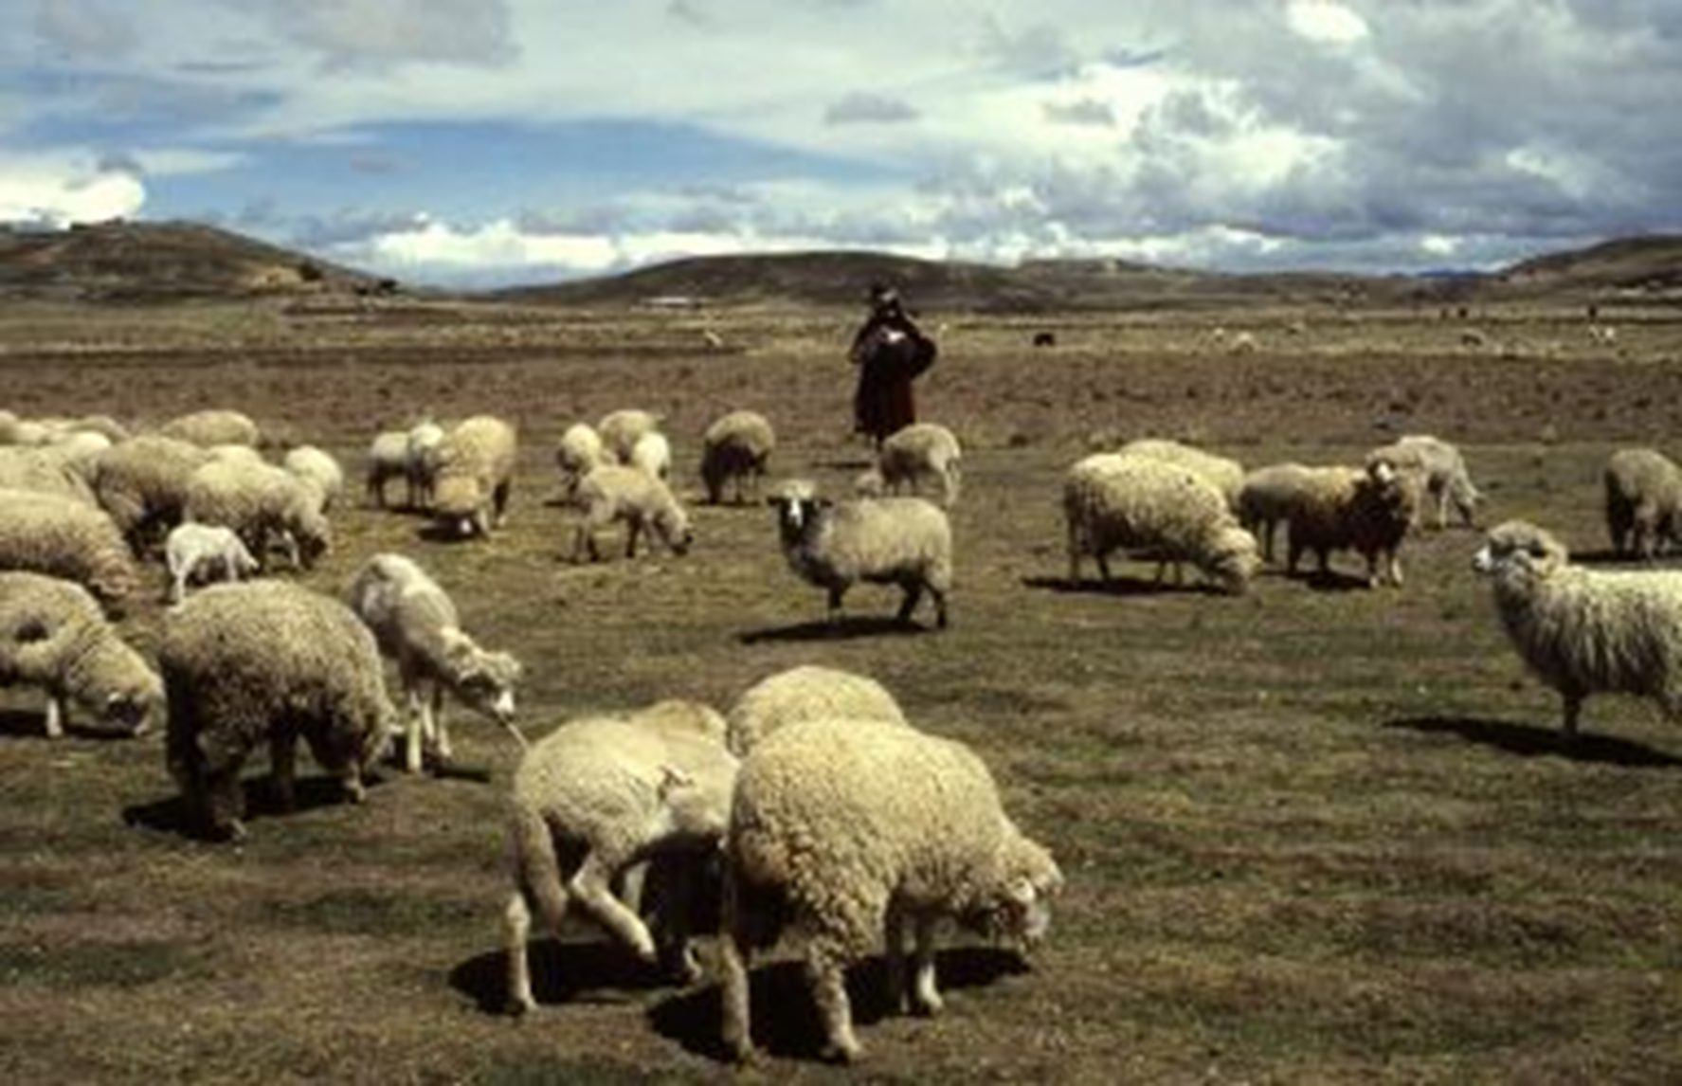
The Agricultural Society

Slide 14
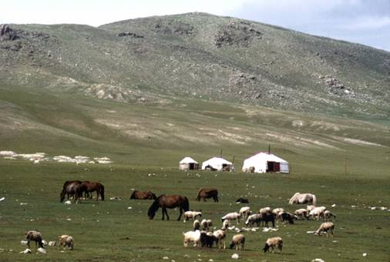
The Agricultural Society

Slide 15
The Phases of Culture
Phases 1 and 2 (Nomadic and Agricultural Societies) are both subsistence economies.
In a subsistence economy, all labor goes towards meeting the needs to keep people alive.
In the next three phases of culture a surplus is created, leading to wealth and expansion.

Slide 16
The Specialized Society
In a specialized society, people develop occupations in order to meet demands.
With specialization, surplus food and materials are created leading to the development of trade.
Specialization includes training in a particular skill.
This creates workers that produce more at a higher quality.
Training takes place in the family.
Geography gives some villages different resources than others.
Interdependence on resources between villages is increased.
Rivers gain greater importance as the need to trade on them increases.
Along important trade routes towns begin to develop.
A town is a village with a central market.

Slide 17
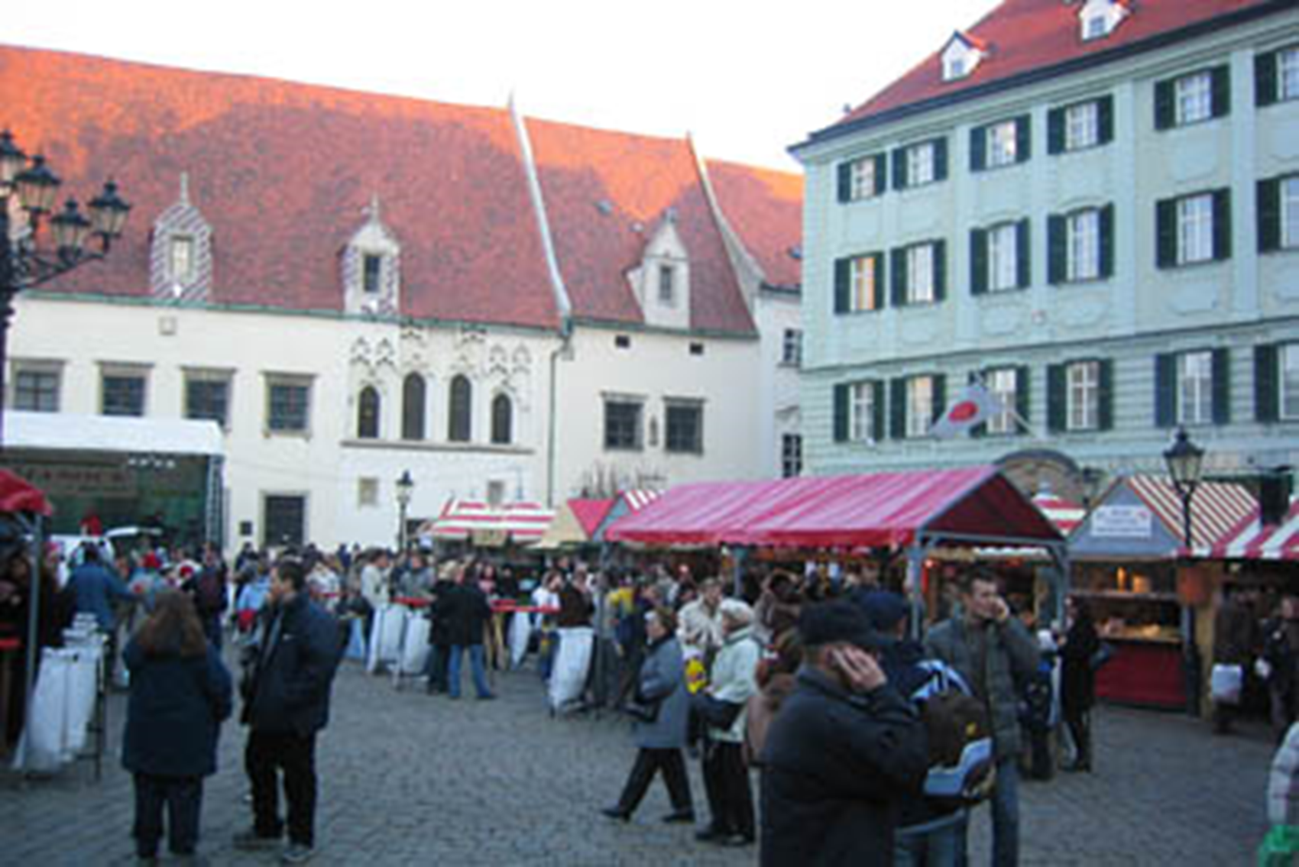
Villages and Towns
Village
Town

Slide 18
The Civilized Society
The key to power is control of trade.
Trade networks grew between regions.
Cities developed from towns into centers of power based on control of trade.
City-state: An independent city with a complex government that controls the surrounding towns and villages.
The first civilizations began as city-states near river systems.

Slide 19
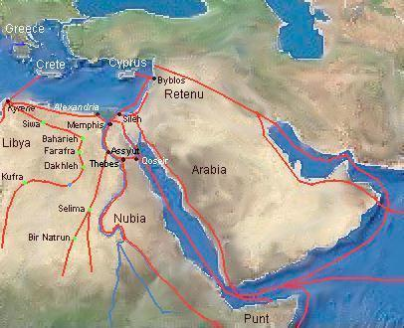
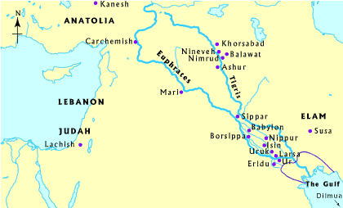
Trade Routes

Slide 20
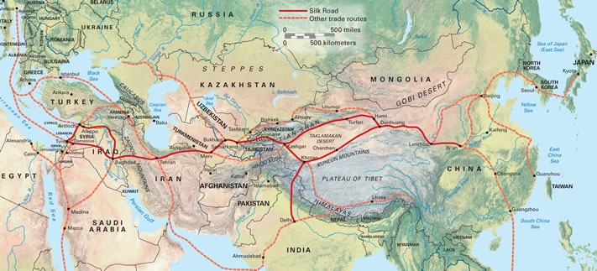
Trade Routes

Slide 21
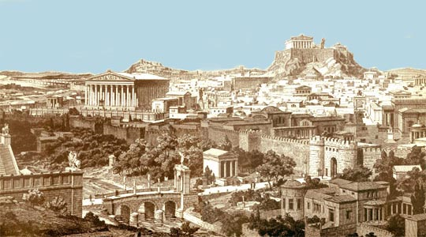
City-State

Slide 22
The Civilized Society
Civilizations developed with complex organizations which were highly specialized in all elements of culture.
Writing
The first writing developed to keep track of trade.
Scribes were officials who could read and write and kept the records of the religion/government.
Priest-kings led the city-states as both rulers of the government and religion.
Interdependence developed between regions.
River systems increased in significance to control trade.
City-states combined to form kingdoms and contiguous empires.
Social Classes developed based on specialization
The caste systems developed in some societies in order to maintain social order.

Slide 23
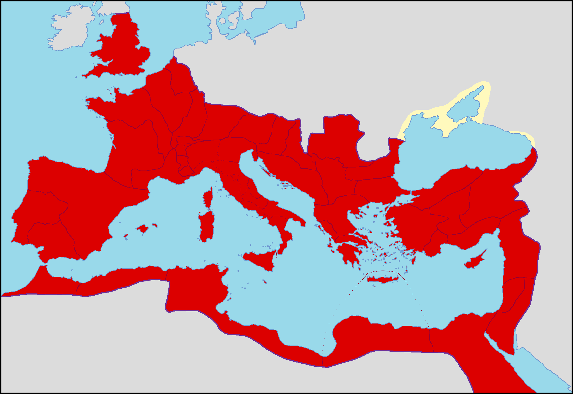
Roman Empire

Slide 24
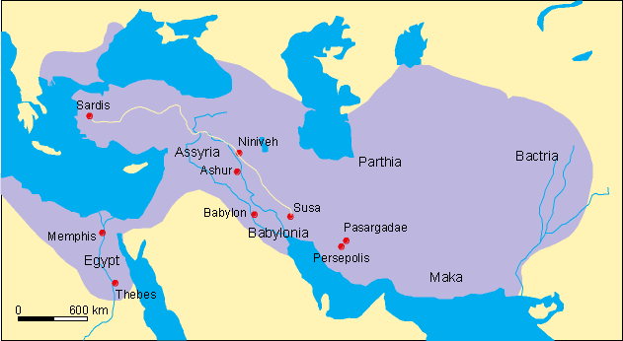
Persian Empire

Slide 25
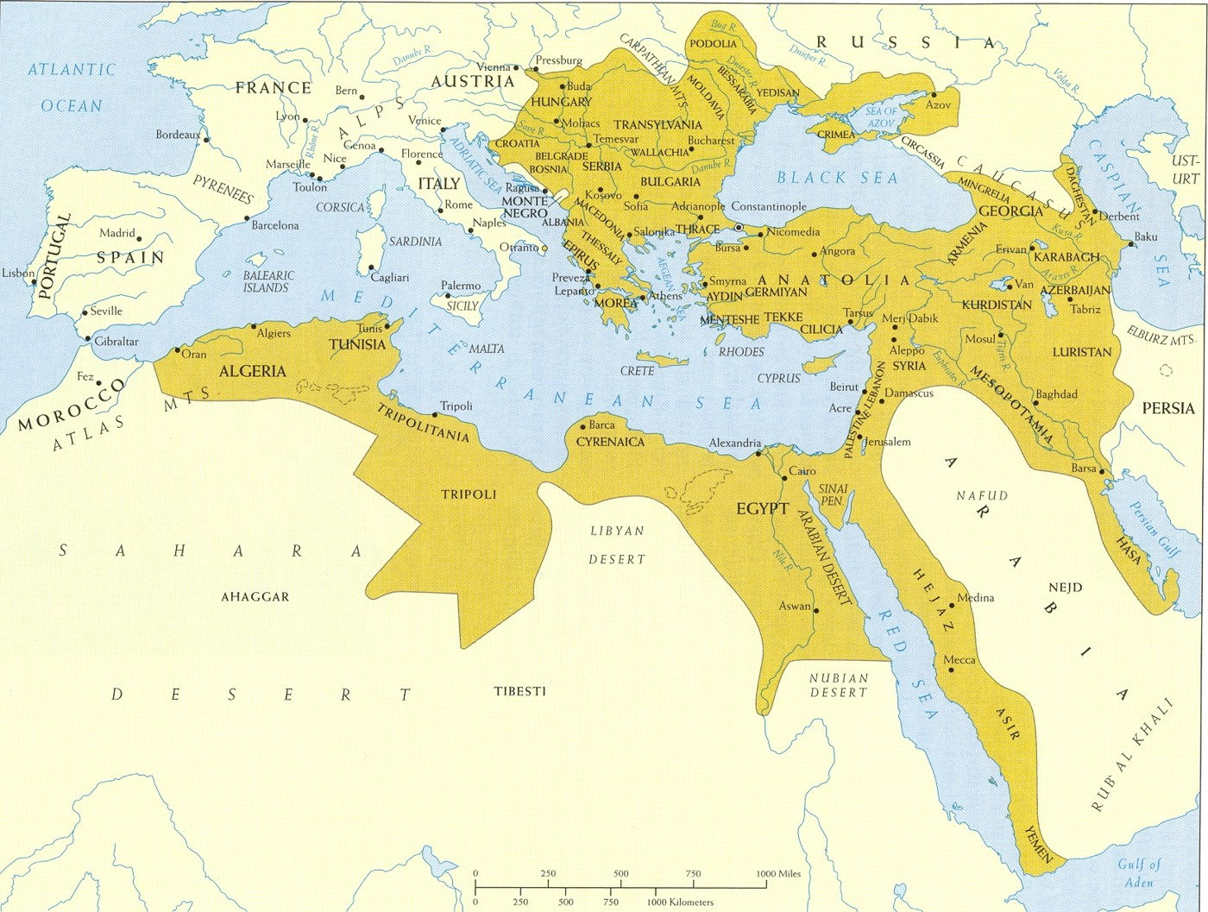
Ottoman Empire

Slide 26
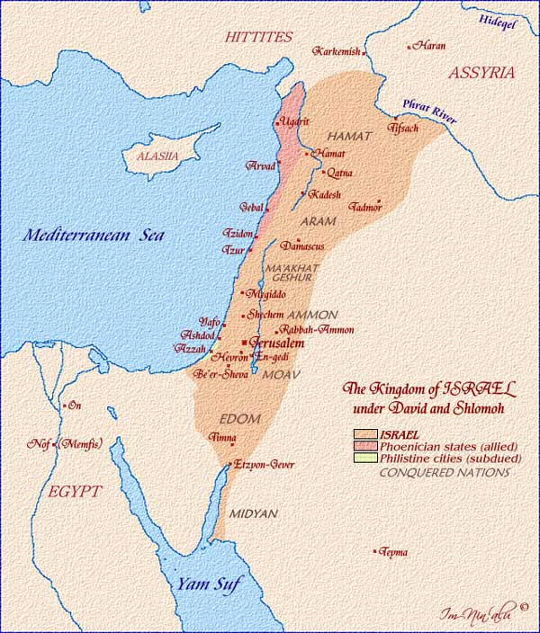
Kingdom of Israel

Slide 27
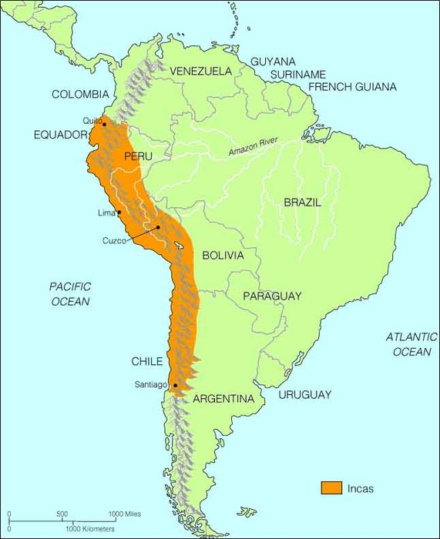
Incan Empire

Slide 28
The Industrial Society
The Industrial Revolution brought about significant changes to human culture:
Machines replaced hand tools.
New energy sources replaced human and animal power.
Urbanization, the growth of cities, began on a global scale.
The extended family is being replaced by the nuclear family.
Challenges emerged to the elite and the class/caste system.
River systems increased in significance as a power source (while still facilitating trade).
The Industrial Revolution led to the need for natural resources and new markets.
The need for natural resources led to imperialism.

Slide 29
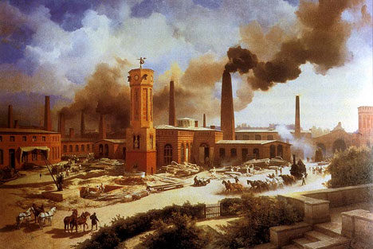
The Industrialized Society

Slide 30
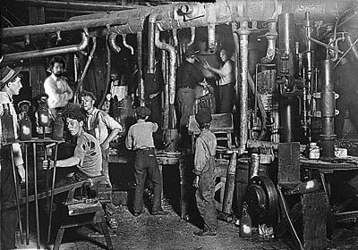
The Industrialized Society

Slide 31
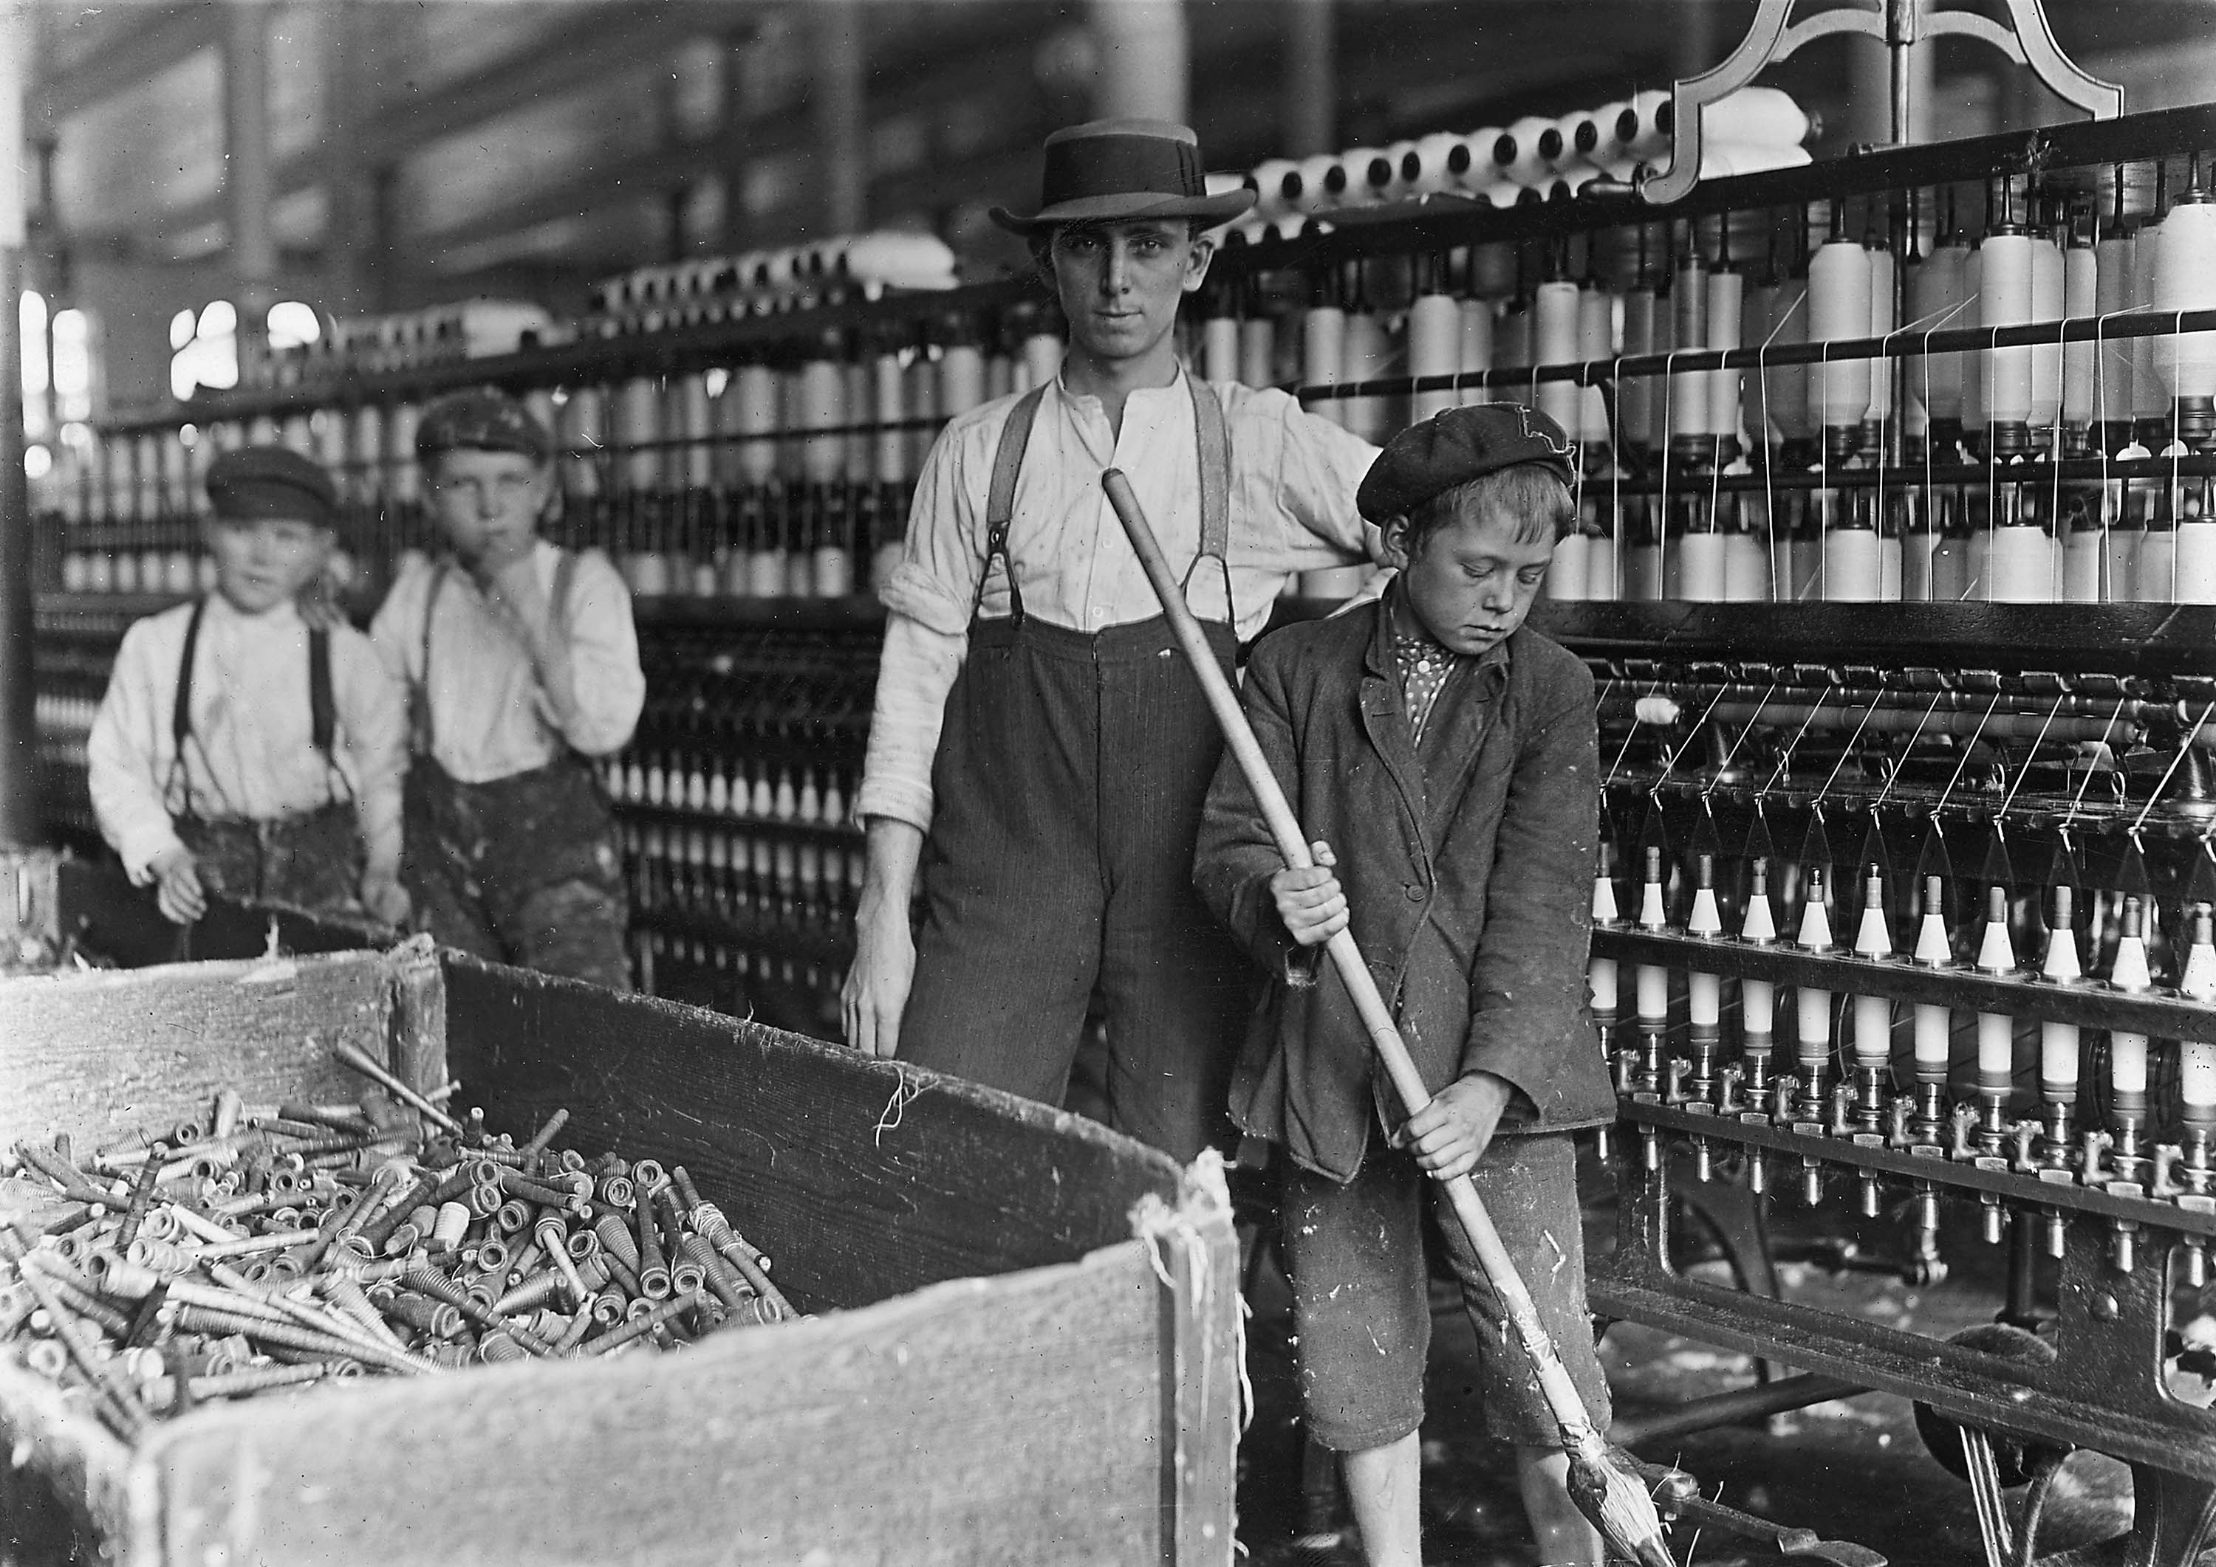
The Industrialized Society

Slide 32
The Industrial Society
Imperialism
In order to fuel the needs of industry, major powers sought to imperialize the planet.
The need for new markets led to westernization.
Imperialism produced westernization
As European control spread, other cultures began to adopt western culture.
These empires were not contiguous
Four Types of Imperialism
Sphere of Influence: Area in which a foreign nation has special economic privileges.
Protectorate: Region with its own government controlled from outside.
Colony: Region that is settled and directly ruled by the imperialist country.
Annexation: To make the colony a formal part of the imperialist nation.
Imperialism led to nationalism: Pride in and loyalty to one’s nation and rebellion against imperialism.

Slide 33
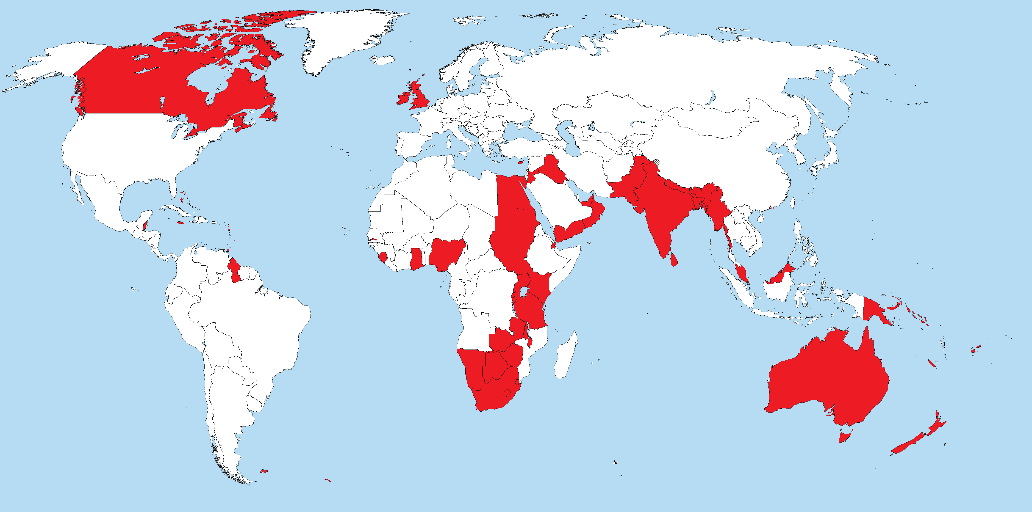
Industrial Empires

Slide 34
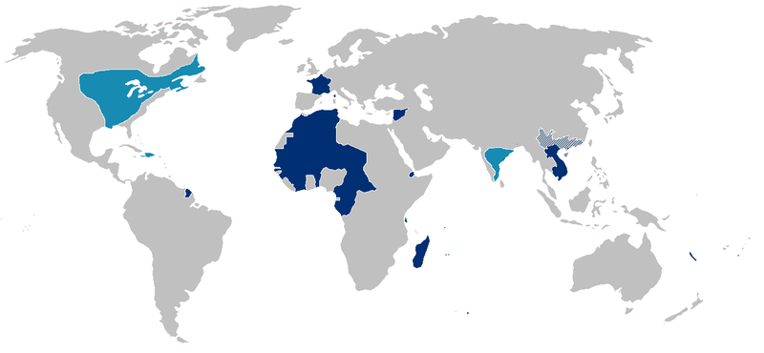
Industrial Empires

